Slide 1


Slide 2
Fun Facts:
The earliest remnants of wine were discovered in Iran dating back to the Neolithic period (8500-4000 B.C.)
Native yeasts accidentally came in contact with grapes stored in containers

Slide 3
Wine Reviews
Stephanie, Chris, Yadi & Miko

Slide 4
Theme
Why?
Geo-spatial Mapping
Creative potential for visualizations
WINE!

Slide 5
Features
Choropleth Map of Wine Reviews Density
Multi-Axis Scatter Plot of Wine Scores
SQLite Database/API Flask
Box Plot Visualization of Reviewers’ Scores

Slide 6
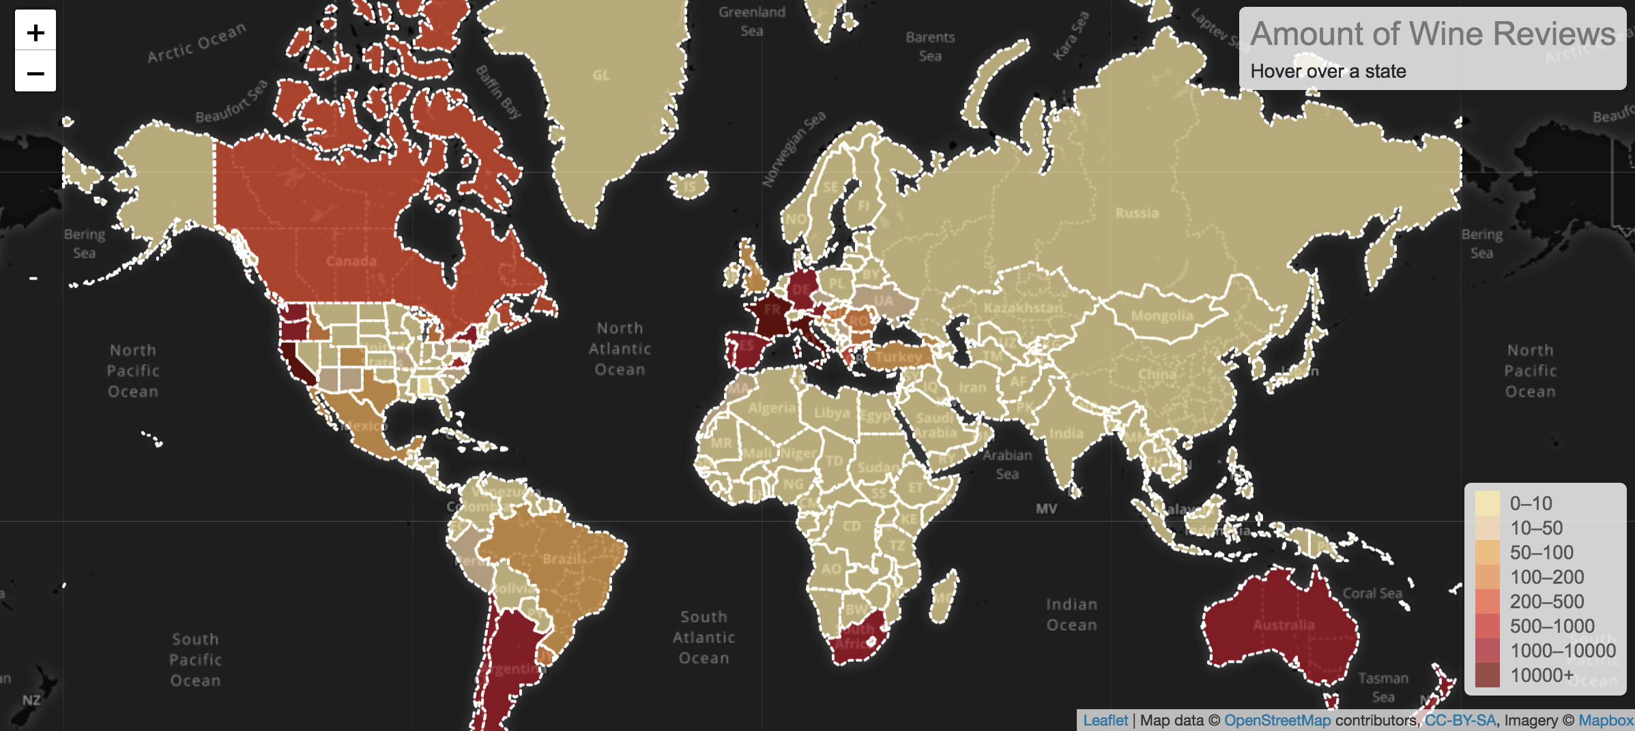
Choropleth Map of Wine Reviews Density

Slide 7
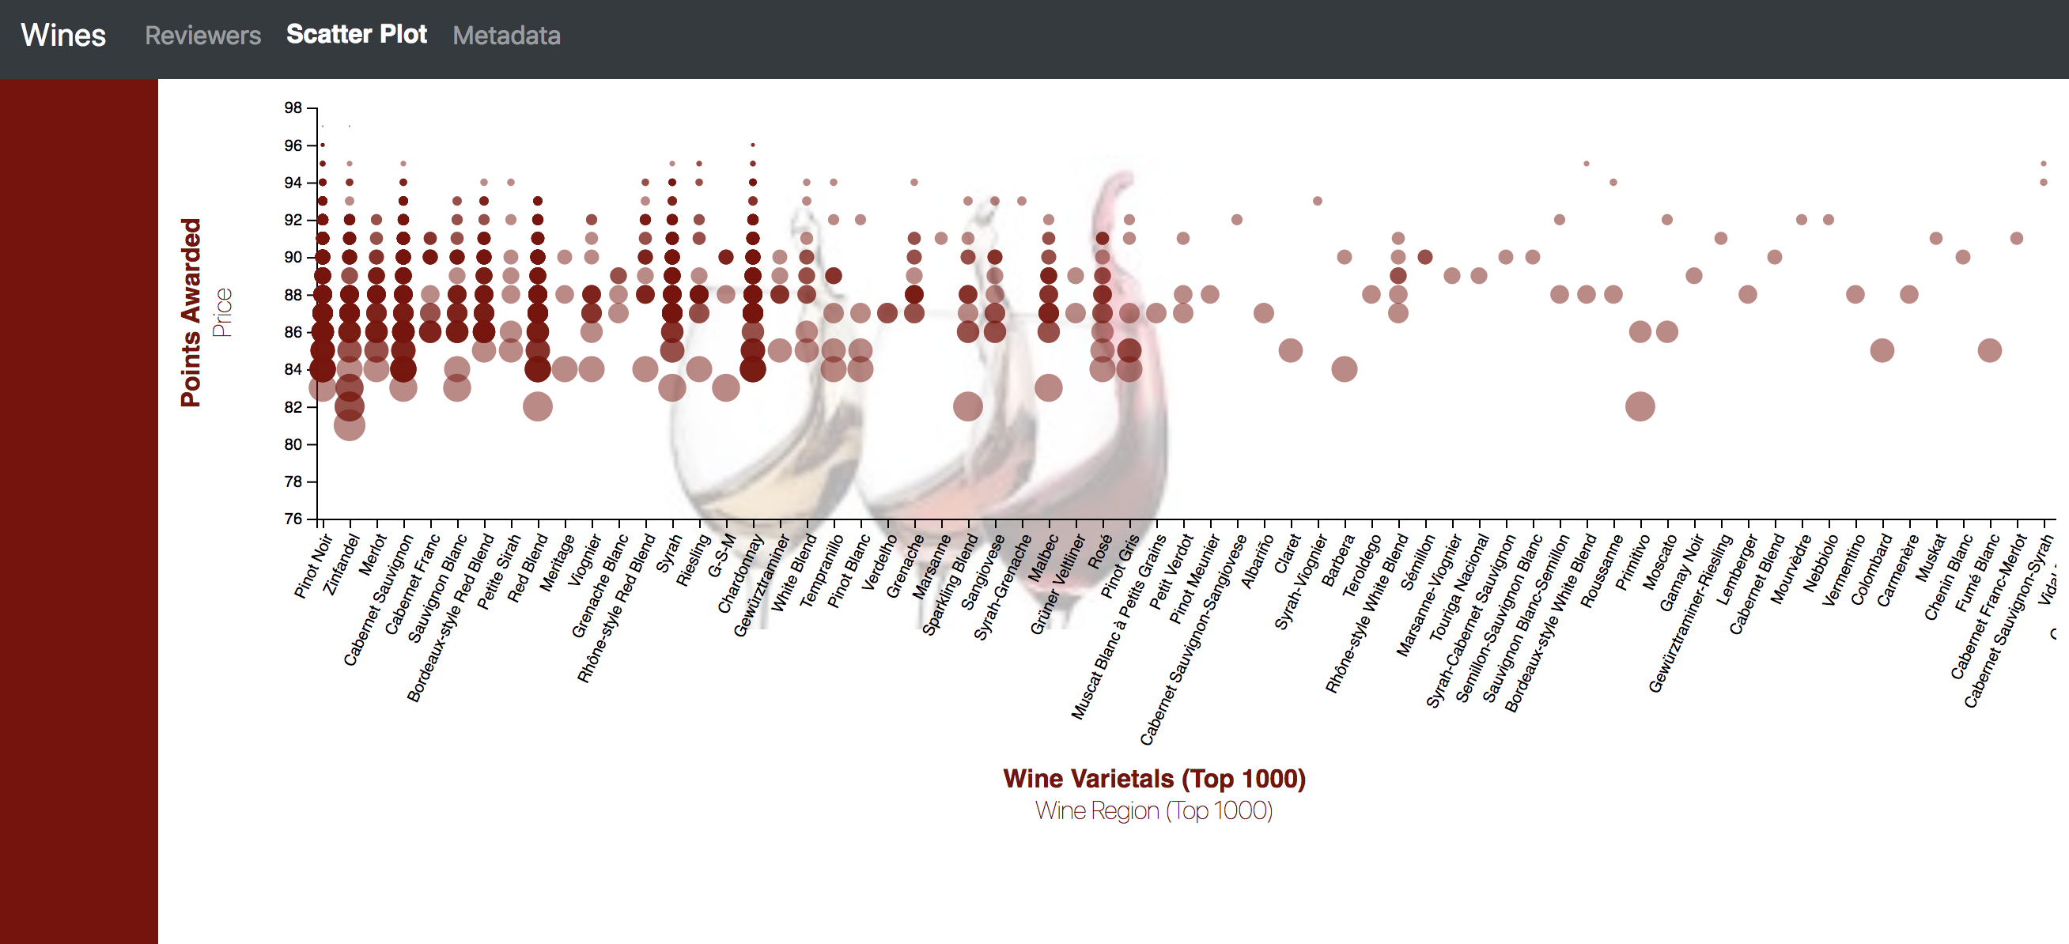
Multi-Axis Scatter Plot of Wine Scores

Slide 8
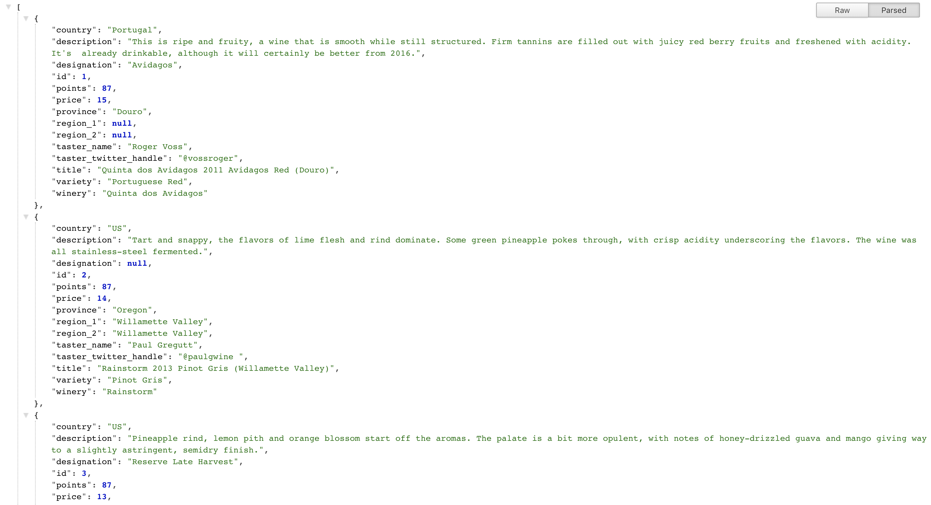
SQLite Database/API Flask

Slide 9
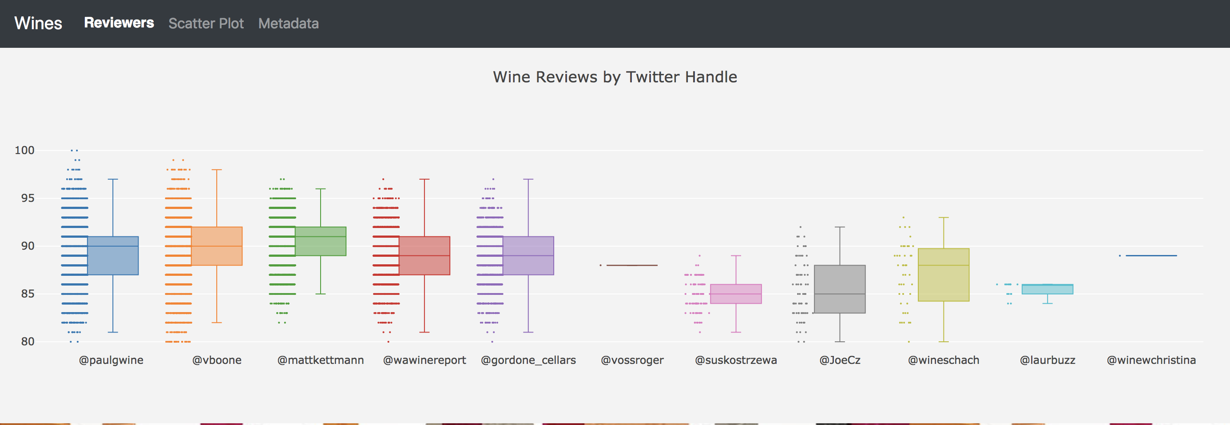
Box Plot Visualization of Reviewers’ Scores

Slide 10
Sources
Wine_Reviews.csv
GeoJSONs by Country
GeoJSONS by States
Notes:
Chrloropleth, Boundaries

Slide 11
Data Engineering Process
Merged the two GeoJSONs to include state detail for the US
Consolidated blends into two category
Drop outlier wine prices over $300 from dataset

Slide 12
Challenges
Incorporating all Technologies
JS, Python, SQL, Flask
Merging/Iterating the JSONS files
Country == Province == State
State level detail was important (US Sampling)

Slide 13
Biases
US based magazine with more focus on US producers
No clear correlation between Price/Region
No correlation between price & points
No best reviewers
Didn’t utilize full scale of measurement

Slide 14
WebSite preview

Slide 15
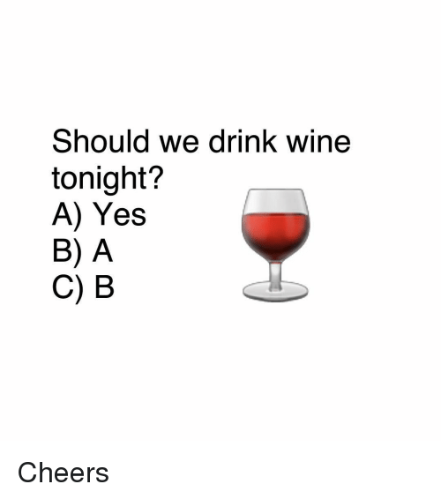
Questions?

